Slide 1
Appraisal Desk
Utilizing NLC LOOP

Slide 2
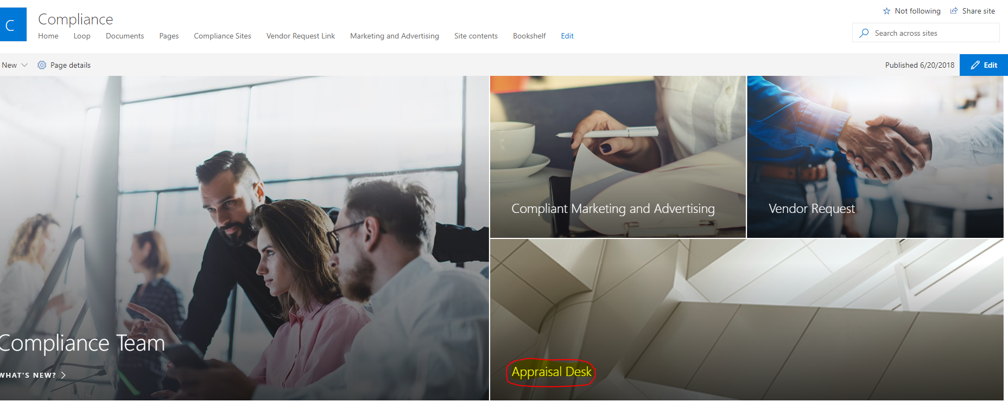
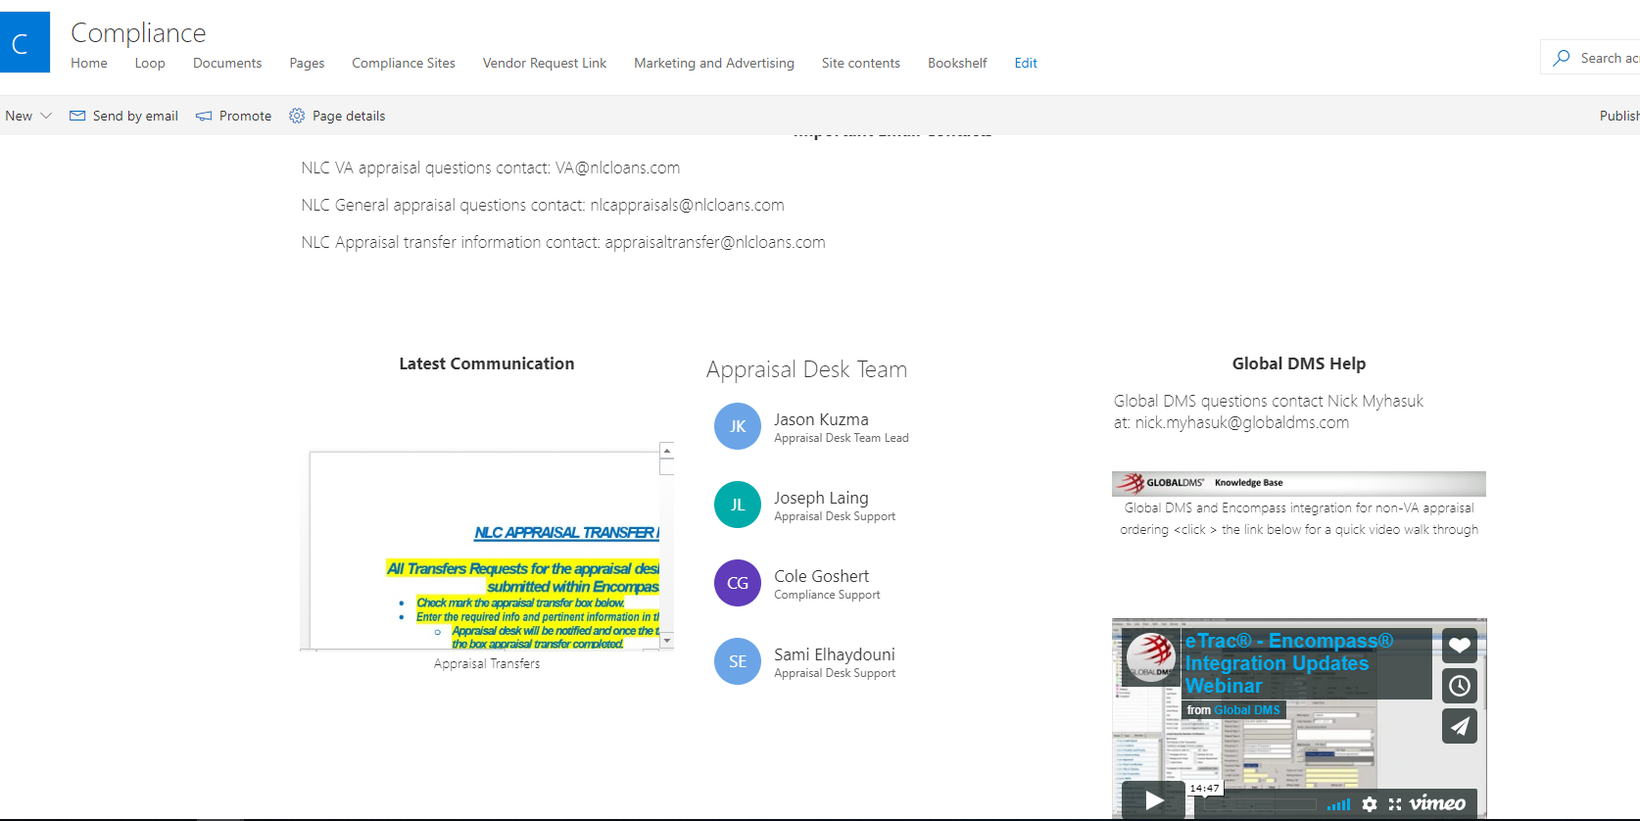
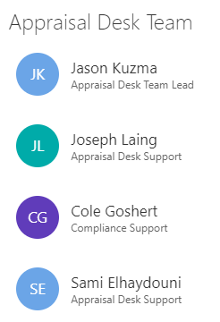
Meet our Team

Slide 3
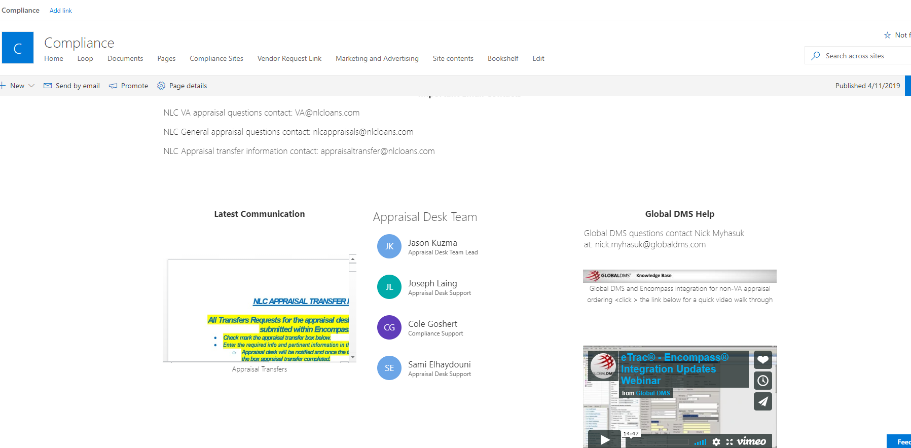
Resources
Contact information for our team
Latest communication from our team
Training video for Etrac-Encompass integration
Location for all of our appraisal processes

Slide 4
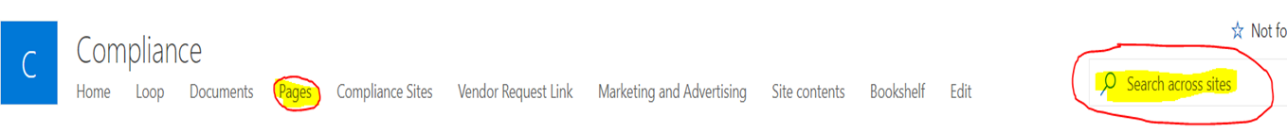
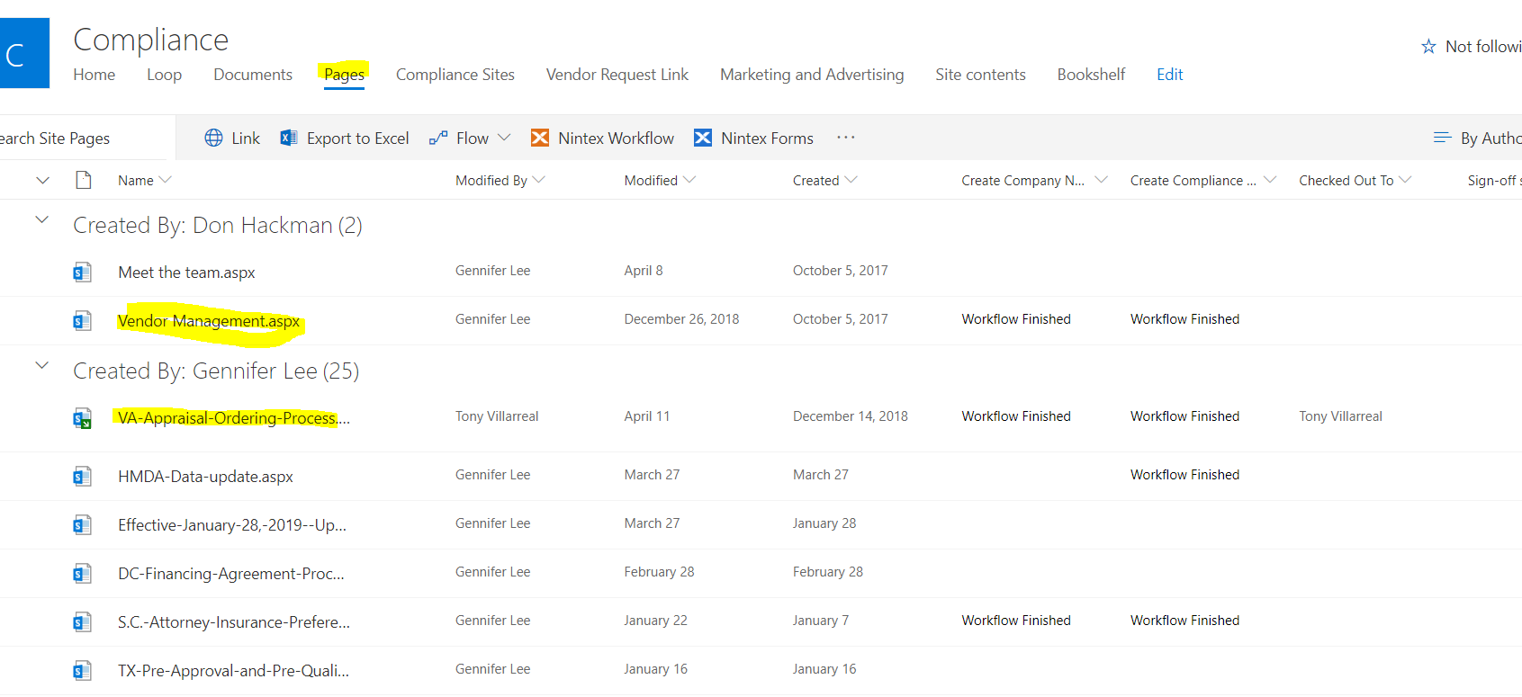
Information is a click away

Slide 5

Questions

Slide 6
Nations Lending Corporation University
Nlcu
Online training platform

Slide 7


Required Training Courses
NLC Advertisement
Workday Essentials
Nations Lending Employee handbook
Employee loan policy
Consumer Complaints
The world of TRID
Fraud
Anti Money Laundering
Recognizing the impact of the Safe Act
Preparing the LE and CD
ATR/QM
This Photo by Unknown Author is licensed under CC BY-NC-ND

Slide 8

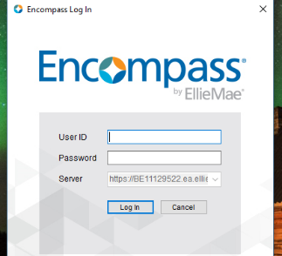
Accessing Your courses
Use your Encompass provided ID and password.

Slide 9
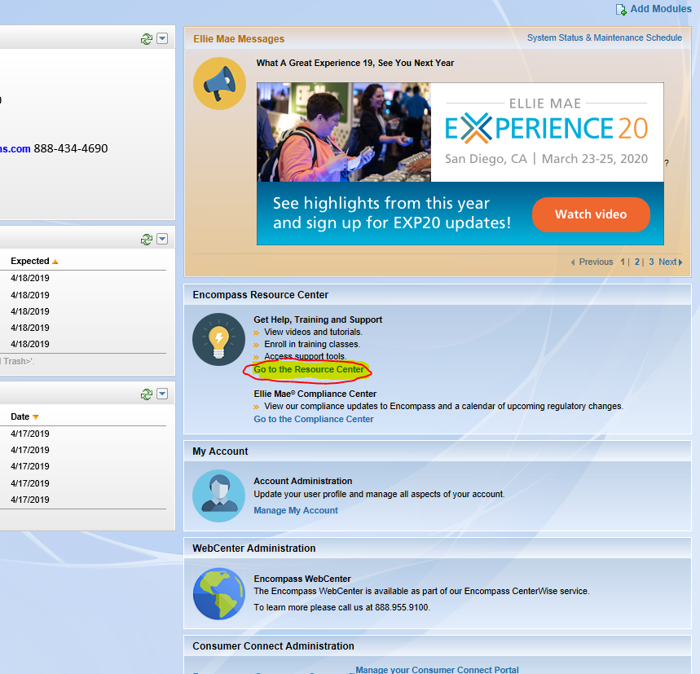
Encompass home screen
Click on “Go to Resource Center”
NOTE:
Make sure you have disabled your pop-up blocker

Slide 10
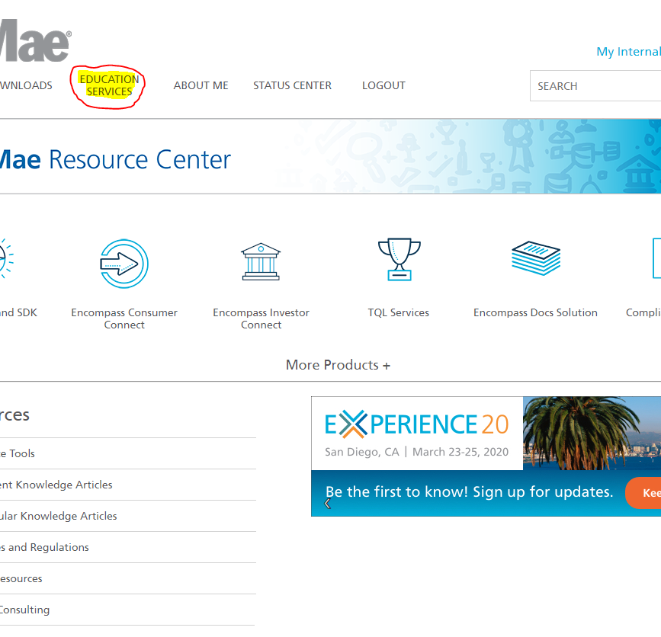
EllieMae Resource center home page
Select “Education Services”

Slide 11
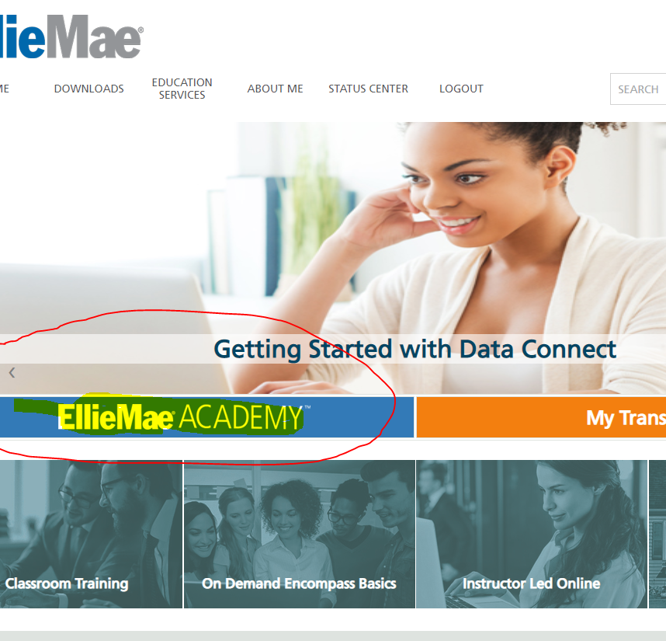
Education Services home page
Select EllieMae Academy

Slide 12

Lobby
You may click on the blue writing “Tired of waiting? Click here to continue!” to refresh the screen.

Slide 13
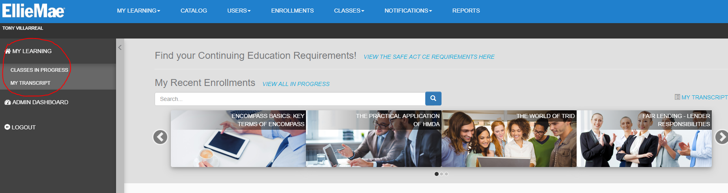
Learning Dashboard

Slide 14

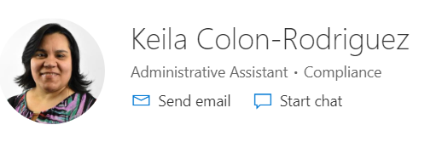
Questions?
Important contact information
NLCU@nationslending.com
(440)-527-6688
This Photo by Unknown Author is licensed under CC BY-SA

Slide 15
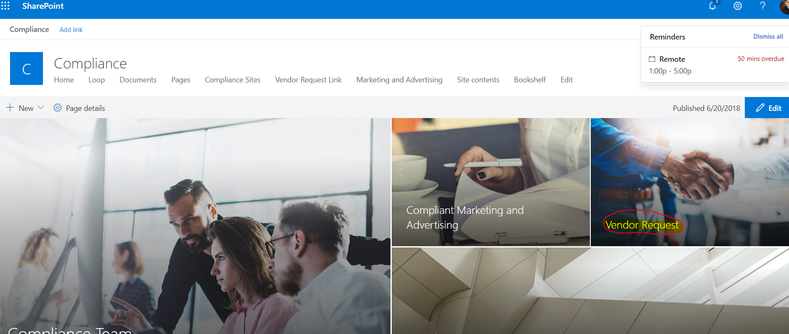
Vendor Management – Vendor Request
From the Compliance Site in NLCLOOP click on “Vendor Request”

Slide 16
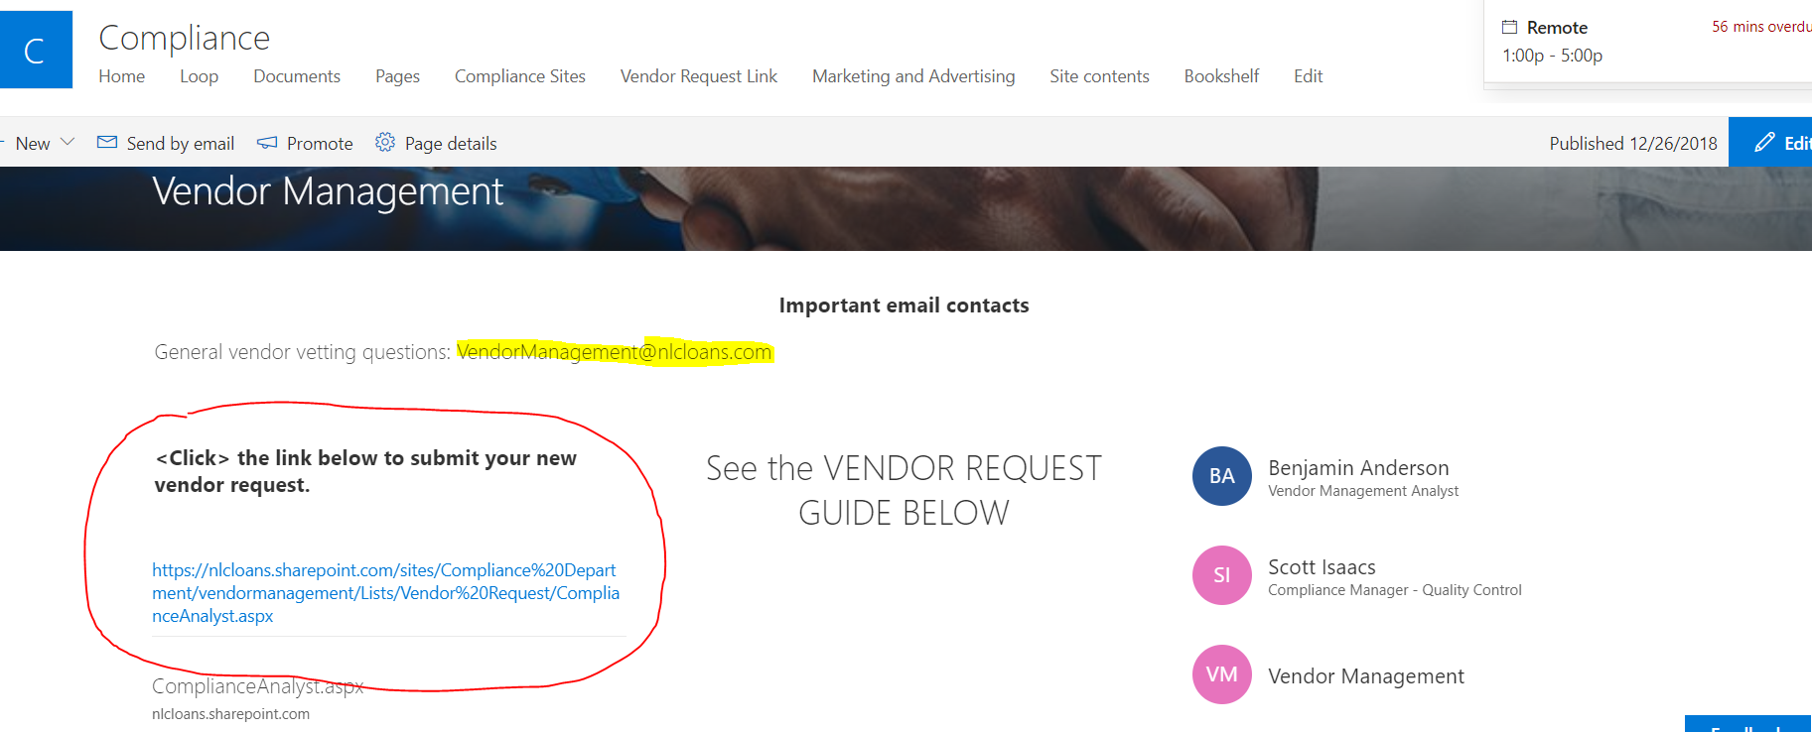
Vendor Management Page
Information on how to submit your new vendor request (only Managers can submit vendor requests)
Contact information for the team
Vendor Management Email for questions
Vendor Request Guide

Slide 17

The Process and Procedure

Slide 18

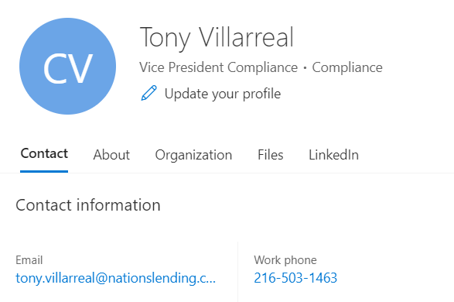

THE end- Questions?
This Photo by Unknown Author is licensed under CC BY-NC-ND
This Photo by Unknown Author is licensed under CC BY

